Slide 1
Enlisted Promotions (MMPB-11)
Maj Daniel A. Moore
Enlisted Promotions Head
MSgt Carolin Chavez
Enlisted Promotions Chief

Slide 2
Promotion Section (MMPB-1) Mission
To conduct regular and reserve promotion boards in order to ensure every Marine (officer and enlisted) has a fair and equitable opportunity for advancement to the next grade. MMPB-1 provides support operations for accurate, timely, and quality service associated with all aspects of the officer and enlisted promotion processes.
2

Slide 3
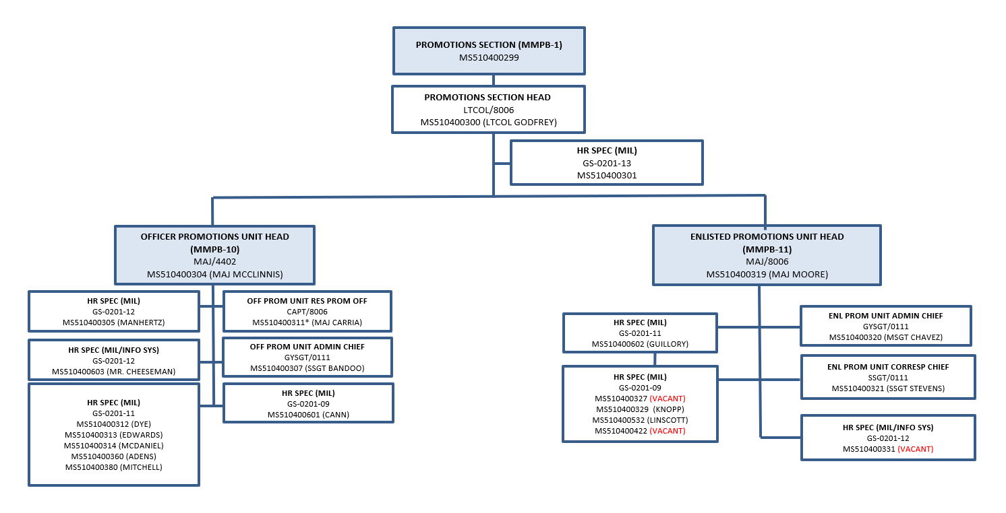
Promotion Section (MMPB-1)
3

Slide 4
MMBP-11 Responsibilities
Convene/Administer SNCO (Regular and Reserve) Selection Boards per year:
FY24 Schedule
AR/SMCR/IRR SNCO’s – 16 Jul 24 (9 wks)
FY25 Schedule (Tentative)
E8/E9 – 15 Oct 24 (8 wks)
E7 – 14 Jan 25 (8 wks)
AR SNCO’s – 4 Feb 25 (2 wks)
E6 – 8 Apr 25 (9 wks)
SMCR/IRR SNCO’s – 16 Jul 25 (7 wks)
Effect monthly promotions
SNCO promotion Delay/Revoke Process
Remedial Promotion Requests
Monthly SNCO Enlisted Remedial Selection Boards (ERSB)
Junior Marine remedial/non-competitive promotion requests
Meritorious Promotions
Posthumous Promotions
PERB/BCNR Advisory Opinions
Special Promotion Authority
DON tracker/Marine mail/personal letters/CONGRINT responses
4

Slide 5
Board Process

Slide 6
Pre-Board Actions
Board Schedule published via MARADMIN (Spring)
Convening MARADMINs
Convene dates/updated information
Promotion zones
Personal responsibilities
How and where to submit update material
Contact information
Published Timeline
60-day AC: Initial
30-day AC: Changes
90/45 SMCR/IRR
6

Slide 7
Marine’s Responsibility
Familiarize yourself with the promotion schedule
Read convening notices/MARADMINS
Know when your board meets
Check your OMPF (MOL) and MBS and ensure they are accurate and complete
Send in update material (PME)
Communicate with the board on important issues
Confirm receipt of material by MMPB-11
Letter of Non-Selection- Marine will be briefed as a “1”.
7

Slide 8
Command’s Responsibility
Counsel Marines on their personal responsibility for their OMPF/MBS/PME
Ensure update material are submitted early
Maintain visibility over the board schedule
Complete FITREPs in a timely manner
ID adjudicated adverse information to the board
8

Slide 9
The Population/Record
Population
MPP/RA: Provides the Zones and Allocations
MMPB-2: OMPF (MMPB-22) / FITREPS (MMPB-23)
MMSR: FMCR / TDRL / PLD
MMEA: No Further Service / Lateral Move
MCRC: WO / MECEP
Record
MCTFS
Ongoing adverse material
Training
PME Completion
MCMAP, PFT, CFT
9

Slide 10
Enlisted Board Membership
21 members (Officer / SNCO)
2 - 3 recorders
Reflects the diversity of the Corps
Board President: 0-6
Air/Ground mix: 01, 02, 03, 04,… 75/60,
Operating Forces, HQMC/MARFORs, major installations, Supporting Establishment, MCRC, MARSOC represented
Minority/female representation
Very diverse, well-represented slice of Corps
10

Slide 11
Enlisted Precepts
Commandant’s guidance
Board membership
Selection criteria of best and fully qualified
Professional Military Education
Special Duty Assignments
Bloom where you’re planted
Adverse information
Zero defect guidance
Letter of Non-Selection- Marine removed from population
11

Slide 12
Eligible Population
AZ
Above Zone & In Zone are briefed as equal
AZ/IZ masked for board members and not called out in brief
Board President reviews BZ to determine competitiveness
Most MOS’ 1 - 4 considered from BZ
MOS’ with larger BZ consideration
0111, 0369, 0629, 3537
IZ
BZ
12

Slide 13
Board Actions (Step 1 of 3)
PREP CASE BRIEF VOTE
Cases assigned randomly by computer
45-60 minute prep time
BZ looked at by Board President/assigned for brief
Digital OMPF
Case file w/ update material
13

Slide 14
Board Actions (Step 2 of 3)
PREP CASE BRIEF VOTE
All AZ + IZ cases briefed
Only selected BZ briefed
3 minutes per case
Brief in IMOS size order alphabetically
Entire record briefed
Board members take notes (DBR/notebook/paper/excel)
14

Slide 15
Board Actions (Step 2 of 3)
PREP CASE BRIEF VOTE
Now Briefing: (Rank/Name/MOS):
1. I recommend this Marine as a: (1-6)
2. Within Height/Weight Standards (Y/N):
3. PME (MarineNet PME, Fully PME, Waiver (Y/N):
4. Letters (Ltr of explanation/Non-selection to Board (Y/N):
5. Adverse Material (Y/N/Details):
6. Special Duty Assignments/Highly Qualified/Higher Qualified Screenable billets:
7. Additional Military Education:
8. Civilian Education (Associates/Bachelors/Masters/PhD):
9. Combat/Deployments/Operations:
10. Joint Individual Augment/Transition Team/Special Operation Capability Specialist:
11. Training (PFT, CFT, RIFLE, PISTOL, MCAMAP, Languages):
12. Awards:
13. JEPES Average CHAR: MSN: LDR (2.5 is average):
0.0 – 0.9 “Below Expectations”, 1.0 – 1.9 “Working Toward Expectations”, 2.0 – 3.0 “Meeting Expectations”, 3.1 – 4.0 “Exceed Expectations”, 4.1 – 5.0 “Exceptional”
14. Relative Value/RO Assessment
RS:
At processing Majority of THIS Marines Fitreps are in the:
Upper (good), Middle (average), or Lower (bottom) third
Cumulatively Majority of THIS Marines Fitreps are in the:
Upper (good), Middle (average), or Lower (bottom) third
RO:
At processing Majority of OTHER Marines are graded:
Above (bottom), With (average), or Below (good)
Cumulatively Majority of OTHER Marines are graded:
Above (bottom), With (average), or Below (good)
PREVIOUS RS Comments:
CURRENT RS Comments:
PREVIOUS RO Comments:
CURRENT RO Comments:
15. Again, I recommend this Marine a:
6 = Eminently qualified, 5 = Above Average, 4 = Average, 3 = Below Average, 2 = Not Recommended, 1 = EPME Incomplete/Request Non-Selection
15

Slide 16
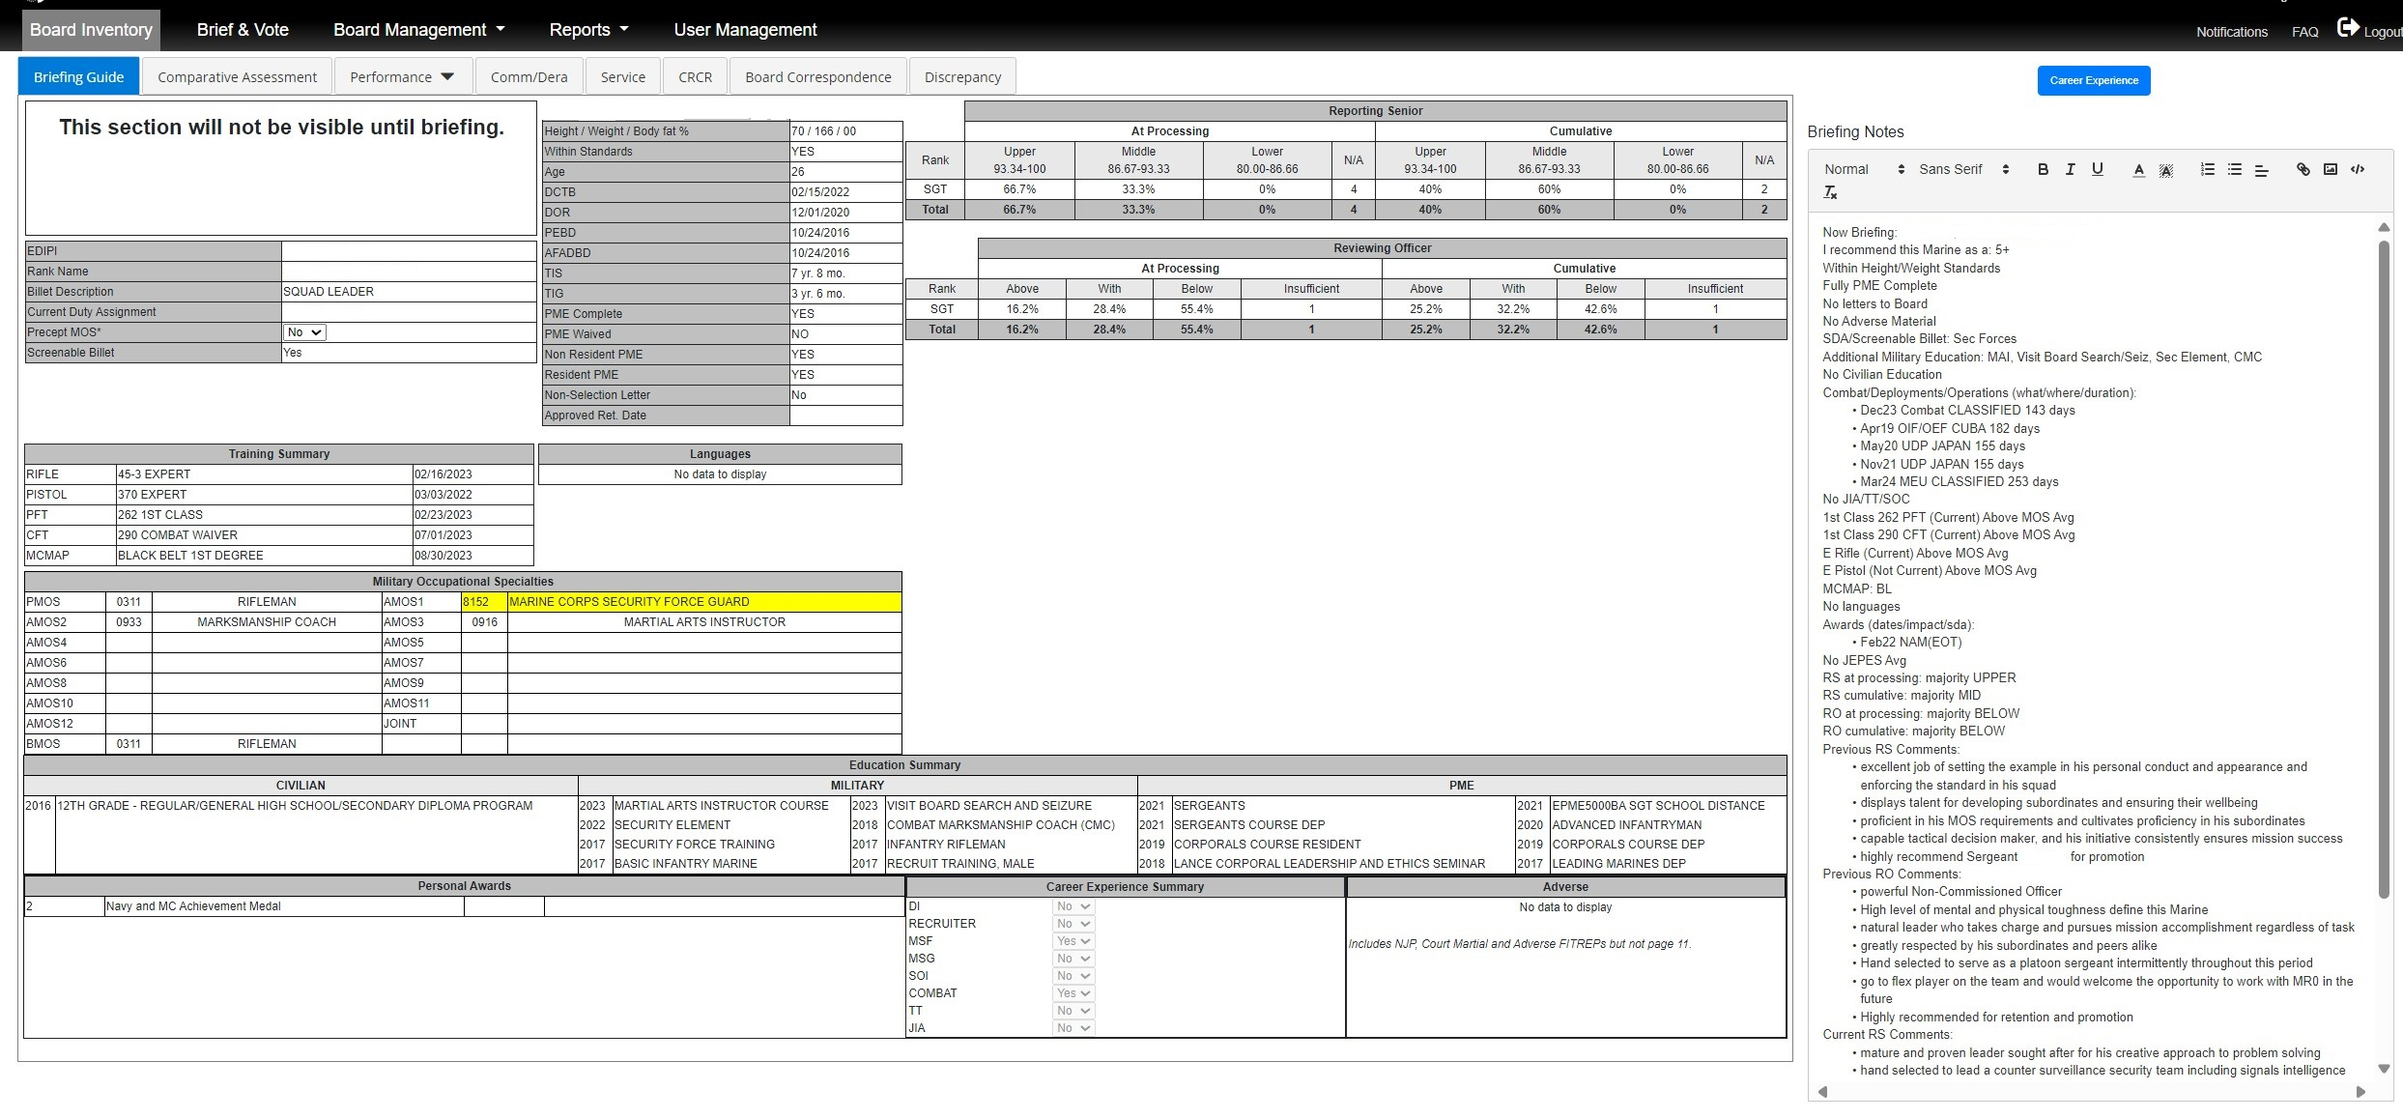
16
Notes:
Briefing Guide

Slide 17
Board Actions (Step 3 of 3)
PREP CASE BRIEF VOTE
Voting occurs after all Marines are briefed
Secret ballot
Select to allocation by IMOS
Best and fully qualified
Shortfalls occur when not enough qualified Marines are available to be selected
17

Slide 18
Voting (example)
Yes
No
Case/Vote
Total Selects
21 | 0 | 142 | 142
20 | 1 | 25 | 167
19 | 2 | 23 | 190
18 | 3 | 7 | 197
17 | 4 | 10 | 207
16 | 5 | 6 | 213
15 | 6 | 3 | 216
14 | 7 | 5 | 221
13 | 8 | 2 | 223
12 | 9 | 5 | 228
11 | 10 | 1 | 229
225 Allocations
223 Selects
5 Tied (Need 2 More)
Non-selects
18

Slide 19
“Possible” Reasons Not Selected
Did not get enough votes
PME status
Substandard performance
Adverse information (NJP, WT, DUI, etc)
(Violations of core values)
Marksmanship/PFT/CFT failure
Extremely competitive/not enough allocations
Exact reason is generally not known but 21 sets of eyes makes it a fair process
19

Slide 20
Post Board
Board Report – Lists SNCOs selected by board
Announcement – MARADMIN published announcing selection and OBS requirements
Undelivered Appointments – Code ran for failed selection
Marine prepares for possible remedial board
20

Slide 21
Fiscal Year 2024 Staff Sergeant Selection Board
Colonel Matthew T. McSorley
Board President
Maj Daniel A. Moore
Enlisted Promotion Head
MMPB, M&RA

Slide 22
Board Membership
Number of Board Members: 21
Rank:
(1) Colonel
(1) Lieutenant Colonel
(2) Majors
(2) CWO3
(3) Sergeants Major
(3) Master Gunnery Sergeants
(4) First Sergeants
(5) Master Sergeants
Gender:
(4) Female
(17) Male
Diversity:
(11) Minorities
Board Recorders: (3)

Slide 23
Board Process
Purpose: consider the best and fully qualified Marines for promotion to meet the needs of the Marine Corps.
Total AZ/IZ cases: 5,547
~ 277 cases per member increase by 14 from FY23
Total BZ cases: 1,896
President screened for premier/non-premier
Pulled 255 into IZ for consideration
Selection Board convened 17 April 2024
Monday – Saturday (Memorial Day 72)
0630-1830, with 10 minute breaks approx. every hour
Prepped, briefed, and voted by IMOS size order (45 days)
Days only preparing: 7 / 16%
Days only briefing: 11 / 24%
Days combined preparing/briefing: 26 / 58%
Voting: 2.5 hrs x 6 sessions (Fridays/ w briefing) 2%
Prep time was approximately 45 minutes per case.
Briefing time allocation:
3:00 (all Marines who completed MarineNet course)
Discussions done between briefs to not take up allocated briefing time
No brief (Marines who did not complete MarineNet or requested non-selection)

Slide 24
Trends
Factors from highest to lowest related to assessment of competitiveness (FitRep, SDA, MOS Credibility, Training, OMPF, Education, Combat Experience)
Fitreps
Section I/K comments made Marines MORE competitive for selection:
“Clear explanation of a Marines future potential and leadership ability. MOS credibility and if an individual was performing ahead of their peers or at a level beyond their rank or tenure.”
"Being specific of the Marine's leadership and performance capabilities. RS and RO stating verbatim where they would rank the Marine in the voting system and why.”
Section I/K comments made Marines LESS competitive for selection
“Promote with Peers, promote with contemporaries, does work commensurate with his rank, Do not Promote, accomplishes tasks when asked.”
“Promote at the needs of the Marine Corps. We looked at a comment like this and took it to mean Don’t Promote.”
“Generic information that was bland and provided no depth to gaining understanding of the Marine's true performance. Captured data/numbers as if they were writing an award. That information is a waste and takes away from what else you can be telling me about the Marine.”
“PULLED FROM BOARD MEMBER COMPLETED CAREER COUNSELOR SURVEYS”

Slide 25
Trends (continued)
SDA/Type I/II: Ranked higher then on previous board
Were SDA Fitness Reports viewed as being more favorable than FMF or Combat Fitness Reports?
“SDAs were viewed favorable but the Fitness Reports themselves did not matter unless the RS/RO said the Marine was doing "outstanding". Majority of Marines I saw had average to below average reports on SDAs and I did not hold that against them.”
“It mattered more if they are excelling in and out of MOS. Capturing the whole Marine concept and ensuring the Marine Corps requirements are meet.”
How did having an SDA/Type I/Type II screenable billet effect a Marines competitiveness?
“Average performance on an SDA was considered to be more favorable than above average performance with no SDA. Highly qualified-screenable billets and Higher-qualified screenable billets were positives but did not make the Marine more competitive than above average performance and no SDA.”
“Above avg performance is above avg performance and I recognized that with a higher mark regardless of if MRO had an SDA or not. If it came down to 1 Slot with two similar Marines and one had an SDA, it would be a tie breaker.”
Only 19% of the population considered had an SDA
837 Selected with SDA 270 Not Selected with SDA
2821 Selected without SDA 1874 Not Selected without SDA
“PULLED FROM BOARD MEMBER COMPLETED CAREER COUNSELOR SURVEYS”

Slide 26
Trends (continued)
MOS Credibility: Difficult to assess when combined with SDA
“Add (ONLY) the required Cert's into OMPF that specifically follow MOS Roadmap. Ensure Billet Description is correct. Ensure the RS/RO speak directly to the Marines MOS Roadmap; present, and future. The Marine can write a letter to the board to summarize their roadmap if the MBS isn't clear.”
“Highly important especially MOS’ such as CID, MARSOC, EOD MOS’s such as these are lateral move and should have a time in MOS requirement for qualifications for promotion to SSgt.”
Training: PFT / CFT: 250 – 300, MCMAP Black Belt
OMPF: Ranked higher on this board
“Letters of appreciation, Marine Net Certs just flooded the 'schools' section and everyone either ignored it completely or missed more important documents because they quickly scrolled past them”
“Most of the documents in the Service tab did not add any value.” “Board members combed through them to look for Pg. 11s and 6105s.”
Board focused on adversity in grade particularly focusing on BCP, ARI, PAC violations.
“BCP was not recommend for promotion, NJP’s within the last year were not recommended, for 6105’s it depended.”
“Anything within the year was an automatic 2 for me. Past adversity was only an issue if it was consistent.”
“PULLED FROM BOARD MEMBER COMPLETED CAREER COUNSELOR SURVEYS”

Slide 27
Trends (continued)
Education: Focused education verses broad
Board members focused on education that tied directly back to MOS. College degree increased competitiveness combined with military education completion.
Enlisted Joint PME ranked higher then RCLF or NWC.
Combat: Serving in a tax exclusion area versus a combat deployment
“Being in combat is luck/timing.” “Many of the Marines did not have combat fitness reports.”
“PULLED FROM BOARD MEMBER COMPLETED CAREER COUNSELOR SURVEYS”

Slide 28
Call Outs
Overall Selection DECREASE
FY23: 66.9%
FY24: 63.0%
3.9% decrease
BZ Selection INCREASE
FY23: 10.8% of the BZ was both briefed and selected
FY24: 11.4% of the BZ was both briefed and selected
0.6% increase
Female Selection DECREASE
FY23: 74.2%
FY24: 68.9%
5.3% decrease
Minority Selection DECREASE
FY23 64.2%
FY24 60.9%
3.3% decrease

Slide 29
SSgt Primary Statistics
 | Race/Ethnic profile for the FY24 SSgt Promotion Board
 | Female |  |  | Male |  |  | Total Female and Male
 | Con | Sel | Sel% | Con | Sel | Sel% | Con | Sel | Sel%
White | 288 | 199 | 69.1% | 2897 | 1865 | 64.4% | 3185 | 2064 | 64.8%
Black | 104 | 58 | 55.8% | 602 | 311 | 51.7% | 706 | 369 | 52.3%
Hispanic | 246 | 175 | 71.1% | 1182 | 725 | 61.3% | 1428 | 900 | 63.0%
Asian/Pac | 23 | 20 | 87.0% | 217 | 144 | 66.4% | 240 | 164 | 68.3%
Amer Ind | 5 | 5 | 100.0% | 31 | 18 | 58.1% | 36 | 23 | 63.9%
Other | 39 | 29 | 74.4% | 168 | 109 | 64.9% | 207 | 138 | 66.7%
Total | 705 | 486 | 68.9% | 5097 | 3172 | 62.2% | 5802 | 3658 | 63.0%
FY20-24 (5-Yr Avg)
 | Female | Male | Total
White | 73.7% | 67.0% | 67.5%
Black | 66.6% | 58.7% | 59.8%
Hispanic | 76.8% | 65.8% | 67.5%
Asia/Pac | 74.6% | 67.2% | 68.0%
Amer Ind | 64.5% | 64.2% | 65.6%
Other | 76.4% | 65.5% | 67.0%
Total | 73.6% | 65.6% | 66.5%
 | Race/Ethnic profile for the FY23 SSgt Promotion Board
 | Female |  |  | Male |  |  | Total Female and Male
 | Con | Sel | Sel% | Con | Sel | Sel% | Con | Sel | Sel%
White | 268 | 196 | 73.1% | 2760 | 1895 | 68.7% | 3028 | 2091 | 69.1%
Black | 102 | 70 | 68.6% | 627 | 365 | 58.2% | 729 | 435 | 59.7%
Hispanic | 182 | 139 | 76.4% | 1060 | 671 | 63.3% | 1242 | 810 | 65.2%
Asian/Pac | 26 | 17 | 65.4% | 184 | 118 | 64.1% | 210 | 135 | 64.3%
Amer Ind | 8 | 8 | 100.0% | 47 | 34 | 72.3% | 55 | 42 | 76.4%
Other | 33 | 29 | 87.9% | 175 | 119 | 68.0% | 208 | 148 | 71.2%
Total | 619 | 459 | 74.2% | 4853 | 3202 | 66.0% | 5472 | 3661 | 66.9%
1% ABOVE | 1% BELOW | COMPARED TO 5 YEAR AVERAGE

Slide 30
SSgt Primary Shortfalls
Top reasons for Shortfalls: PME (289/83%) /Adversity and no additional BZ
IMOS | Population | Allocations | Selected | Short Fall | % of Allocations
0211 | 40 | 39 | 33 | 6 | 15%
0231 | 138 | 138 | 105 | 33 | 24%
0261 | 19 | 18 | 16 | 2 | 11%
0321 | 52 | 52 | 41 | 11 | 21%
0363 | 40 | 40 | 34 | 6 | 15%
0441 | 166 | 162 | 137 | 25 | 15%
0451 | 17 | 17 | 11 | 6 | 35%
0639 | 160 | 160 | 118 | 42 | 26%
0679 | 178 | 178 | 138 | 40 | 22%
0848 | 53 | 53 | 35 | 18 | 34%
0871 | 51 | 50 | 35 | 15 | 30%
2141 | 28 | 28 | 21 | 7 | 25%
2629 | 116 | 116 | 92 | 24 | 21%
2651 | 49 | 49 | 38 | 11 | 22%
2862 | 176 | 172 | 145 | 27 | 16%
3451 | 22 | 22 | 17 | 5 | 23%
4421 | 22 | 22 | 16 | 6 | 27%
5939 | 15 | 15 | 13 | 2 | 13%
IMOS | Population | Allocations | Selected | Short Fall | % of Allocations
5974 | 14 | 14 | 12 | 2 | 14%
5979 | 17 | 17 | 15 | 2 | 12%
6114 | 27 | 23 | 17 | 6 | 26%
6116 | 29 | 27 | 21 | 6 | 22%
6124 | 7 | 7 | 5 | 2 | 29%
6132 | 10 | 10 | 9 | 1 | 10%
6174 | 12 | 12 | 7 | 5 | 42%
6176 | 22 | 21 | 19 | 2 | 10%
6256 | 11 | 11 | 8 | 3 | 27%
6276 | 28 | 28 | 23 | 5 | 18%
6694 | 37 | 37 | 31 | 6 | 16%
6842 | 18 | 18 | 17 | 1 | 6%
7212 | 43 | 43 | 34 | 9 | 21%
7236 | 12 | 11 | 10 | 1 | 9%
7242 | 14 | 14 | 10 | 4 | 29%
7257 | 65 | 60 | 54 | 6 | 10%
Total | 1708 | 1684 | 1337 | 347 | 21%
Previous Short falls
FY24: 34 MOS/Total: 347
FY23: 49 MOS/Total: 295
FY22: 59 MOS/Total: 361
FY21: 50 MOS/Total: 341
RED= 4 YEAR SHORTFALL
BLUE= 3 YEAR SHORTFALL
GREEN= 2 YEAR SHORTFALL
No Color=NEW SHORTFALL

Slide 31
PME Primary Select Statistics
Selected PME Complete: 2810
Selected Sequenced PME: 848
Total Selected: 3658
Non-Selected PME Complete: 1002
Non-Selected Sequenced PME: 505
Non-Selected No EPME: 637
Total Not Selected: 2144
Total Population: 5802
PME complete includes SDA waivers and non-competitive

Slide 32
Sequenced PME Primary Pathway
MARADMIN Published
MMPB-11 screens all selects to confirm completion of MarineNet & resident/seminar course or SDA waiver
Only MarineNet completed and no SDA waiver
Meets PME or SDA waiver requirements
No UD promotion restriction
12 mo UD promotion restriction by MMPB-11
Promoted based on selection #
Completes either resident or seminar within 365 days
Selection number not reached
Selection number passed
Promoted based on selection #
Promote 1st month following PME completion
Start
Preferred COA for Marines / Commands
Commands are encouraged to pull their own reports via Marine On-Line (MOL) to monitor PME completion at the unit level
MMPB-11 will also monitor PME completion to affect monthly promotions
MMPB-11 screens all selectees within 10 days of the board adjourning to determine completion of resident/seminar or waiver (accounts for those who completed PME throughout duration of the board)
MMPB-11 runs 12 mo. promotion restriction on Marines who have not met PME promotion requirements
Within 30 days of selection MARADMIN, Commands ensure Marines acknowledge via Page 11 that they are part of the sequenced PME pipeline
MMPB-11 will screen Marines projected to promote prior to the monthly promotion MARADMIN to remove promotion restriction based on PME completion
Commands will notify MMPB-11 of discrepancies if they believe a Marines record does not properly reflect completion of PME
ETP Authority to waive PME – Dir MM
Extension Authority – Branch Head, MMPB
MMPB-11 continues to screen all Marines to ensure obligated service (OBS) prior to promotion

Slide 33
Alternate Selections
Total selected: 225
79 MOS’
Alternates only selected after meeting primary allocations
56 Alternates selected with sequenced PME
Zone Breakdown
AZ: 64 (28%)
IZ: 151 (67%)
BZ: 10 (5%)
Receive a MOL message and a letter in their OMPF
Do not incur a failure of selection
List posted on MMPB-11 website alphabetically with MOS
No planned stratification of alternates
MMPB-11 maintains list of prioritization based on DOR/AFADBD

Slide 34
Alternate Policy
Notification of Selection
Primaries in MARADMIN with seniority number
Alternates posted via website and MOL message without seniority number
Alternates receive a letter posted in their record signed by Head of MMPB
Activation of Alternate
MMEA starts request and final approval is Dir MM
Alternates promoted after primary list is cleared and only if needed
Primary refusal of orders/OBS
Primary entering a revoke status
HQMC need
Activation of an alternate will not cause a primary to be promoted earlier then originally planned
Alternates maybe frocked once activated
Orders
MMEA and MMPB-11 communicate for activation of alternate before orders issued
Obligated Service timeline
Primaries 60 days after release of MARADMIN
Alternates 30 days after notification of activation
Refusal to gain OBS by primary/alternate makes Marine ineligible for future consideration

Slide 35
Additional Promotion Items

Slide 36
Delay Process
Selected by board, but adverse information found before promotion is affected
Command may request to delay
Command notifies MMPB-11 immediately via email of O5 Naval letter
MMPB-11 will delete “SELGRD” to prevent erroneous promotion and run DCC “ZV”
Command submits detailed report to MMPB-11 within 30 days of initial notification with a minimum of:
First general officer endorsement with a specific recommendation, not simply be “forwarded recommending approval”
Marines’ acknowledgement via naval letter format
Supporting documents. Due to the unique nature of each case, the command is highly encouraged to provide any documentation available that forms the basis of their recommendation to delay:
6105 entry, appointment letter for investigation, notification from NCIS of ongoing investigation, notification to Marine of pending NJP or CM, NAVMC 11512 showing open PAC violation, PT/Ht/Wt NAVMCs, or civilian police report.
Final delay authority rests with Director, MM
Once delay is approved by Dir, MM, command must submit further detailed report through first GO to do close out the case with one of the following:
Revoke
Incurs a failure of selection
Documented in OMPF
Promote
Date of rank may be original if unsubstantiated or later based on final adjudication

Slide 37
SNCO Enlisted Remedial Selection Boards (ERSB)
Similar process as annual boards
Conducted monthly (10 – 20 cases)
Comparison cases used from FY Marine is requesting
Local board members
Approved – Head Enlisted Promotions
Disapproved – Head Promotions Section
Past 3 yrs (MMPB-11)
More than 3 yrs (BCNR)
Common Reasons for Approval
Performance Evaluation Review Board prior to board convening
Board for Correction of Naval Records prior to board convening
Erroneous intended MOS
Selected in wrong MOS
Considered in BZ versus IZ
Erroneous component code
Not considered
Common Reasons for Disapproval
Missing fitness reports
Missing documents in OMPF
Erroneous information in MCTFS (e.g., PFT)
Dissatisfaction with the selection board results
MOS credibility
Billet MOS error

Slide 38
Points of Contact
Col Taylor, B. S.
LtCol Godfrey, J. A.
Maj Moore, D. A.
MSgt Chavez, C.
Major Cook M. J.
Head, Performance Branch
Head, Promotions Section
Head, Enlisted Promotions
SNCOIC, Enlisted Promotions
Head, Officer Promotions
703-784-9700
703-784-9724
703-784-9710
703-784-9717/8
703-784-9703
Address for Selection Board
President, Name of Board
Headquarters, U.S. Marine Corps
Harry Lee Hall
Enlisted Promotions Unit (MMPB-11)
17 Lejeune Rd
Quantico, VA 22134-5104
Address for Routine Correspondence
Commandant of the Marine Corps (MMPB -11)
Headquarters, U.S. Marine Corps
Harry Lee Hall
Enlisted Promotions Unit
17 Lejeune Rd
Quantico, VA 22134-5104

